Slide 1
I/DD
Intellectual disability
Begins before a child is 18
Is a medical diagnosis
Characterized by problems with intellectual functioning
Ability to learn, reason, problem-solve
Characterized by problems with adaptive behavior
Social and life skills
Developmental Disability
Broader category of lifelong challenges that can be intellectual, physical, or both.
WIDE VARIATION IN ABILITIES AND CHALLENGES—
THE VAST MAJORITY ARE NOT IMMEDIATELY VISIBLE

Slide 2
NEEDS AREN’T THAT SPECIAL
BELONGING
CONNECTION
PHYSICAL, EMOTIONAL, PSYCHOLOGICAL SAFETY
PURPOSE
THE OPPORTUNITY TO DEVELOP TO THEIR HIGHEST LEVEL OF INDEPENDENCE

Slide 3
PROGRAMS
RESIDENTIAL
COMMUNITY LIVING ARRANGEMENTS, IN-HOME SUPPORTS, COMMUNITY SUPPORTS
DAY SUPPORT OPTIONS
EMPLOYMENT AND VOCATIONAL SERVICES
GSE, ISE, MICROBUSINESSES
SPORTS AND RECREATION
ENFIELD STARS/SPECIAL OLYMPICS
TOOLS: PERSON-CENTERED PLANNING, SELF-DETERMINATION, SELF-ADVOCACY

Slide 4
NUMBERS
AGE RANGE 19-82
EMPLOYMENT PLACEMENTS
7 GSE AT ATTIC
17 OF 19 HAVE ISE PLACEMENTS
COMMUNITY ENGAGEMENTS
APPROXIMATELY 30 PER WEEK
LON SCORES
FOR THOSE EMPLOYED AVG. SCORE IS A 2
DSO AVG. IS 6, WITH A RANGE OF 3-8
FIRST RESPONDER CALLS
EMS IS CALLED ONCE PER WEEK
(LAST YEAR WAS 52)
POLICE WERE CALLED TO ONE HOME BETWEEN 20-30 TIMES PER MONTH THIS YEAR TO DEAL WITH AN INDIVIDUAL WITH I/DD AND COOCCURING MH NEEDS

Slide 5

MENTAL HEALTH CHALLENGES
ABLEISM
BARRIERS TO CARE
SHORTAGE OF PRACTICITONERS TRAINED TO OFFER MENTAL HEALTH SERVICES TO PEOPLE WITH DISABILITIES
ISOLATION
LACK OF UNIVERSAL SCREENING
UNDERREPORTING
OVER MEDICATING

Slide 6
QUESTION: IF 15% OF THE GENERAL POPULATION IS DISABLED, WHY…
DOES 40% OF THE INCARCERATED POPULATION HAVE A DISABILITY?
IS IT ESTIMATED THAT OVER 50% OF CHILDREN SEXUALLY EXPLOITED OR TRAFFICKED HAVE A DISABILITY?

Slide 7
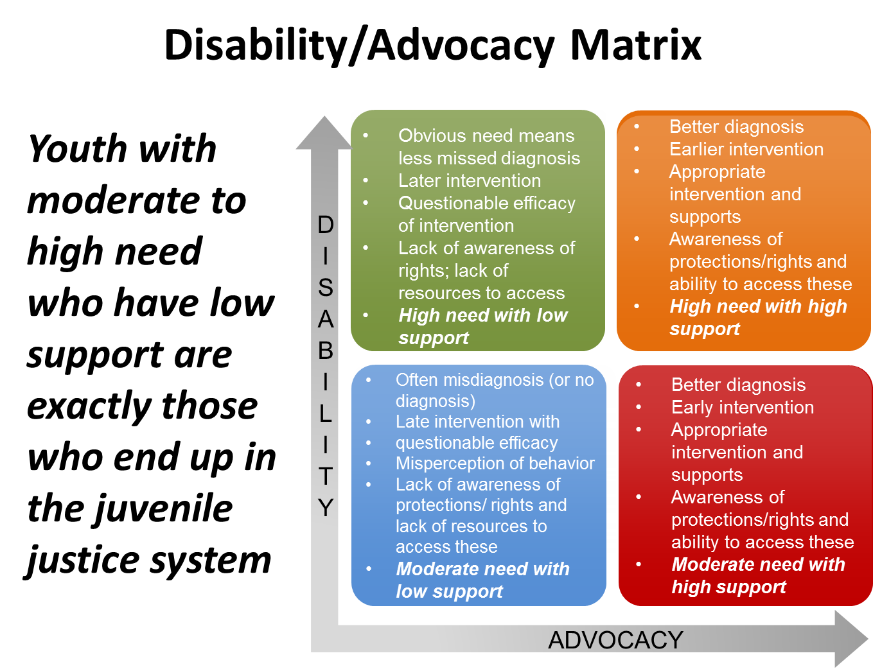
Notes:
Programming

