Slide 1
EPS Overview of Social, Emotional, Mental Health, trauma and Special Needs

Slide 2

About Enfield Public Schools
Approximately 4,800 students
Pre K @ Stowe – Head Start, Integrated Pre K and PK Steam
3 Primary K-2 Schools – Henry Barnard, Hazardville Memorial and Enfield Street School
3 Intermediate 3-5 Schools – Prudence Crandall, Eli Whitney and Parkman
JFK Middle School
Enfield High School
Eagle Academy
Enfield Transitional Learning Academy

Slide 3
Demographics 2022-2023 Data
October 1, 2022 Enrollment
District Count Percent of Total (%)
Female 2,362 48.1
Male 2,542 51.7
Non-Binary 9 0.2
American Indian or Alaska Native n/a n/a
Asian 126 2.6
Black or African American 332 6.8
Hispanic or Latino of any race 1,061 21.6
Native Hawaiian or Other Pacific Islander n/a n/a
Two or More Races 297 6.0
White 3,086 62.8
English Learners/Multilingual Learners 155 3.2
Eligible for Free or Reduced-Price Meals 2,265 46.1

Slide 4
Chronic Absenteeism and Suspension/Expulsion 2022-2023 Data
Chronic Absenteeism Suspension/Expulsion
Female 416 n/a
Male 477 353
Non-Binary 6 n/a
Black or African American 103 74
Hispanic or Latino of any race 240 145
White 475 263
ELL/ Multilingual Learners 32 15
Eligible for F&RL 572 314
Students with Disabilities 261 136
Total 899 (19.3%) 524 (10.3%)
*Chronic Absenteeism, 10% or greater missed days
Number of students qualified as truant under state statute: 19
Number of school-based arrests: 42

Slide 5
Handle with Care Data 2023-2024 StowE 5 Henry Barnard 2 Hazardville Memorial 2 Enfield Street School 4 Prudence Crandall 4 Eli Whitney 3 Parkman 2 JFK Middle School 26 Enfield High School 4 Eagle Academy 4 Total 56

Slide 6
Protective Custodies 2023-2024 Henry Barnard 4 Eli Whitney 1 JFK Middle School 17 Enfield High School 8 Eagle Academy 8 Total 38

Slide 7



Mobile Crisis Data 2023
Referrals for Youth Residing in Enfield​
Referral Sources
Top Presenting Problems
Self/Family -55
School-59
ED’s -16
Top School Referrals: EHS (16) , JFK (11)
140
Risk of Harm to Self (59)
Anxiety/Depression (11)
Disruptive Behavior (20)
Risk of Harm to Others (11)

Slide 8
Mobile Crisis Data 2024 (as of July)
Referrals for Youth Residing in Enfield​
Referral Sources
Top Presenting Problems
Self/Family -29
School-29
ED’s -8
Top School Referrals EHS (12) , JFK (7)
75
Risk of Harm to Self (17)
Anxiety/Depression (2)

Slide 9
Suicide Risk Assessments 2023-2024 Henry Barnard 9 Hazardville Memorial 7 Enfield Street School 12 Prudence Crandall 10 Eli Whitney 9 Parkman 1 JFK Middle School 30 Enfield High School 54 Eagle Academy 13 ETLA 3 Total: 148

Slide 10
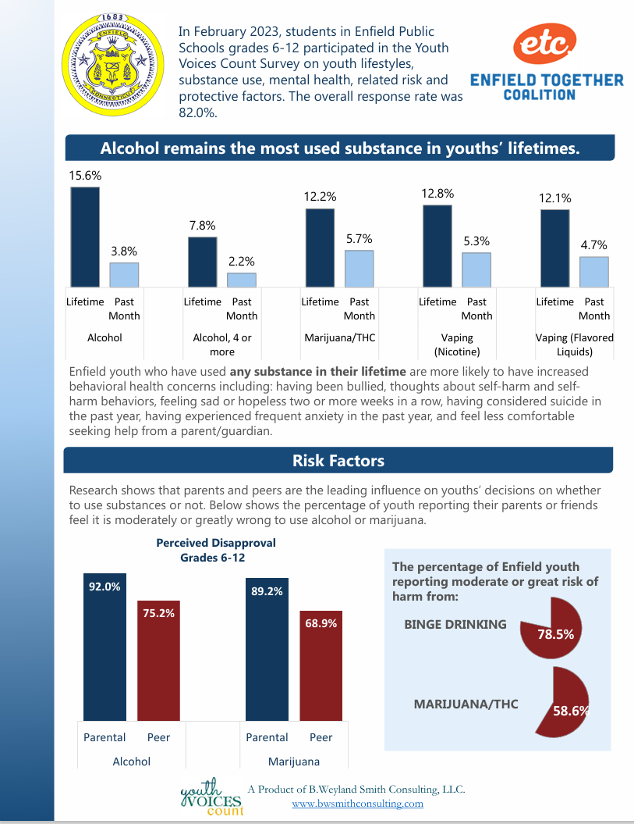

Slide 11
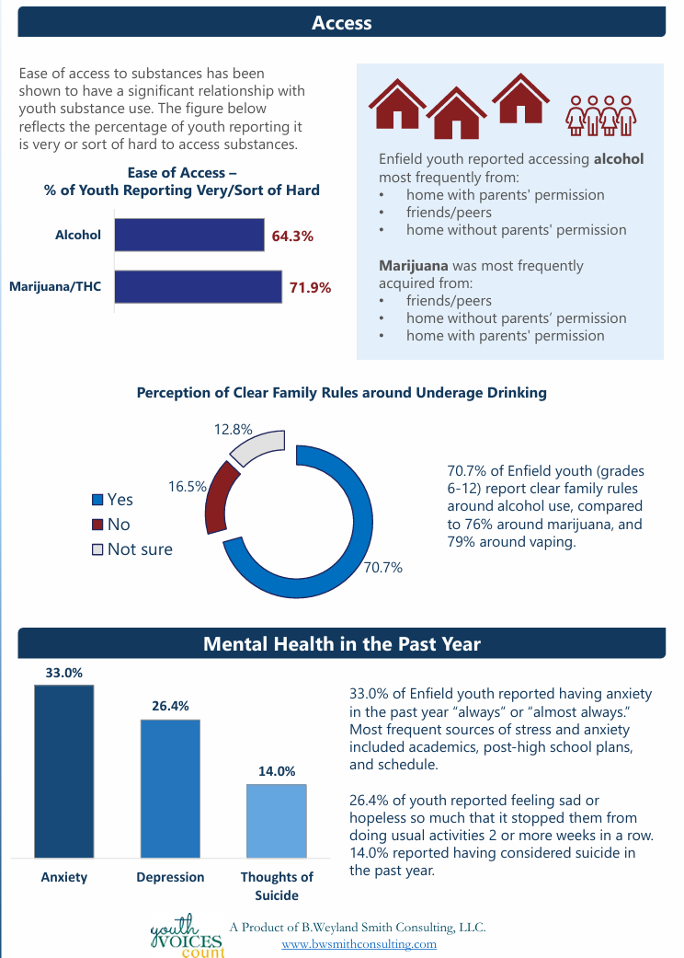

Slide 12
Thank you
Questions?

