Slide 1


Community Health Resources
Enfield Services
Bisrat Abebe, LCSW
Associate Vice President
babebe@chrhealth.org

Slide 2



Our Commitment to Excellence Consistent with our dedication to being Connecticut’s most comprehensive behavioral health provider for adults, children, and families, CHR has received a Gold Seal of Approval™ from The Joint Commission and was recently accredited by the National Commission on Correctional Health Care for opioid treatment programs in six CT jails and prisons.

Slide 3
Services Provided for Enfield Residents in 2024
2,394 Clients reside in Enfield and were treated by CHR
Of the 2,394 residents, 1,710 or 71.4% visited the Enfield clinic with the remaining seeking care in a different CHR setting
Medicaid is the most prevalent insurer with commercial second
Substance use disorder is the most prevalent diagnosis with Depression second, and Anxiety third

Slide 4
Services Provided for Enfield Residents in 2024
54.1% of males, 10.2 percentage points more than the other two groups.
The age band with the highest percentage 29.0% is clients in the 35-50 year’s old age band.
The average age is 38.6 and the median age is 37 year’s old.

Slide 5
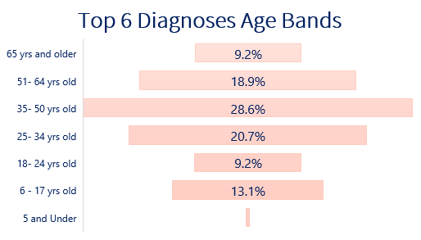
Client Served in Enfield Clinic in 2024
Over 30 different types of programs offered
4,549 clients were served
Depression is the most prevalent primary diagnosis, followed by substance use disorder and anxiety.
9% of total clients served in Enfield experienced homelessness.
* 5 and under is less then 1%

Slide 6
Clients Served in Enfield Clinic in 2024
Race and Ethnicity

Slide 7
Clients Served in Enfield Clinic in 2024
The population served is relatively evenly split between Male and Female
Commercial and Medicaid are the primary insurer for a combined 86% of the Enfield population.
CHR uses Medicaid eligibility as a proxy for lower income.

Slide 8
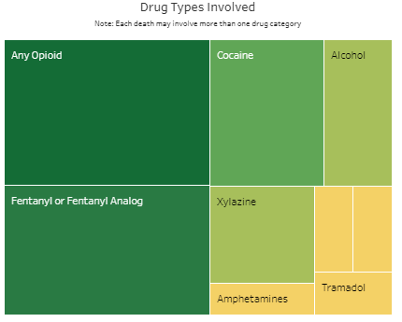
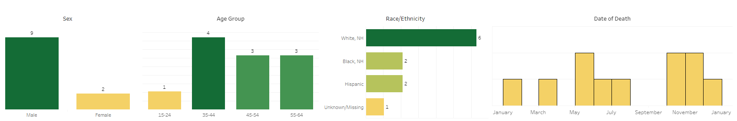
Source: DPH, Connecticut Department of Public Health
In 2023 there were 11 Unintentional and Undetermined Drug Overdose Deaths in Enfield

Slide 9
CHR AVAILABLE SERVICES
Walk in clinic/Open Access
Accepting new clients (Child, Adult and Families)
Reducing barriers to access to care (No waitlist)
Convenient scheduling, evening hours and telehealth options

Slide 10

CHR’s 24hr Crisis Services
Received 24 crisis referrals for Enfield residents
71% of those people had a SUD history
1 in 4 people were Opiate impacted (24%)
33% had some level of Suicidal ideation
Linked or re-linked 16 of those people (67%) to treatment/healthcare.
*Data is from the time-period March 2024 through May 2024

Slide 11
Multiple Stigmatized identities each making the others even more problematic
MOUD/MAT Stigmatization
Carceral Stigmatization
Addiction Stigmatization

Slide 12
Evidence Based Substance Use Treatments Offered
Enfield Pathways:
Informed by Harm Reduction principles (reduce barrier to care and combat stigma)
Provides individualized person- and family-centered care
Medication Assisted Treatment (MAT)
FDA approved medications for addiction disease:
Methadone
Suboxone (Buprenorphine)
Naloxone (Vivitrol)
Current census:180.
60% male, 40% female;
30-34 years old: 17.78%
35-39 years old: 24.44%
40-44 years old: 18.33%

Slide 13
MAT/MOUD services in DOC Locations
7 Locations (Carl Robinson, Cybulski, Osborn, Walker-MacDougal, Hartford, Corrigan)
Census: Total over 575
All men
Majority on Methadone
Post Incarceration Care Coordination/Re-entry Services (Over 92% connected with services)

Slide 14

Thank You!
Bisrat Abebe, LCSW
Associate Vice President
babebe@chrhealth.org
Jason Hoyt, MBA
Data Analytics and Support Manager
jhoyt@chrhealth.org

