Slide 1

Enfield Student Survey Outcomes 2019
Presented April 2020
Presented by Bonnie Smith, MPH, CPH, CPS

Slide 2

ETC Vision & Mission
Vision: The Enfield Together Coalition envisions a community moving forward drug free and finishing strong.
Mission: We are dedicated to reducing and preventing underage drinking and substance use in Enfield through raising awareness, educating parents/youth, and enforcing underage drinking laws.
Vision: The Enfield Together Coalition envisions a community moving forward drug free and finishing strong.
Mission: We are dedicated to reducing and preventing underage drinking and substance use in Enfield through raising awareness, educating pare
nts/youth, and enforcing underage drinking laws.

Slide 3

SAMHSA’s Strategic Prevention Framework and How Data Are Applied
Prioritize problems and community needs
Measure success, prove value (outcomes)
Demonstrate value, secure funding
Build or increase community buy in
ID subpopulations and health disparities
Guide adaptation of EBPPP; increase community awareness; feed social marketing
Prioritize risk factors and identifying evidence-based strategies

Slide 4
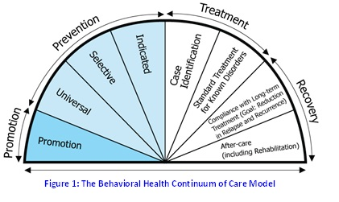
Why prevention and early intervention are essential.
Behaviors and symptoms that signal the development of a behavioral health disorder often manifest two to four years before a disorder is present.
Cost-benefit ratios for early treatment and prevention programs for addictions and mental health programs range from 1:2 to 1:10. This means a $1 investment yields $2 to $10 savings in health costs, criminal and juvenile justice costs, educational costs, and lost productivity.(SAMSHA)
Notes:
https://www.samhsa.gov/prevention

Slide 5
Why prevention and early intervention are essential….
9 out of 10 people who abuse or are addicted to nicotine, alcohol or other drugs began using these substances before they were 18
People who began using addictive substances before age 15 are nearly 7 times likelier to develop a substance problem than those who delay first use until age 21 or older
Every year that substance use is delayed during the period of adolescent brain development, the risk of addiction and substance abuse decreases (www.centeronaddiction.org)
Notes:
https://www.centeronaddiction.org/addiction-prevention/teenage-addiction

Slide 6
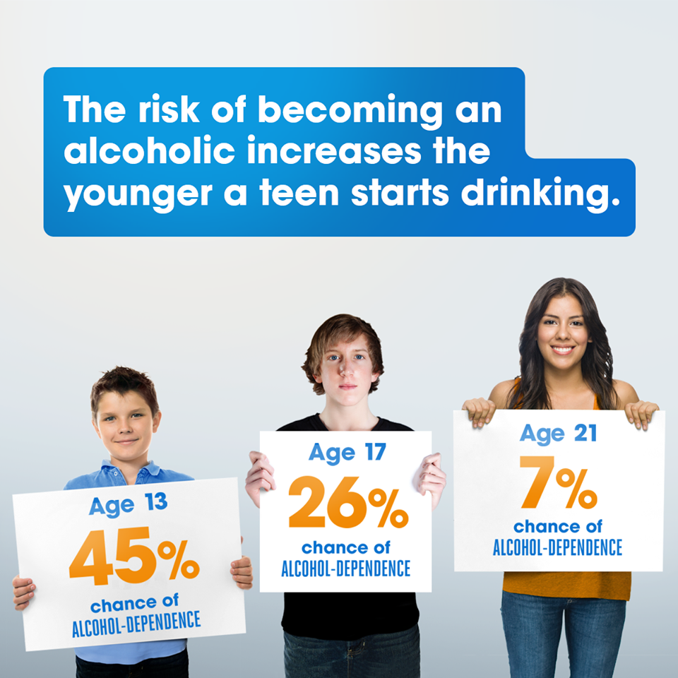

Slide 7
Student Survey Background
November 2019, students from John F. Kennedy Middle School (JFK, grades 6-8) and Enfield High School (EHS, grades 9-12The survey was completely anonymous, no identifying information was collected
Parents had the opportunity to “opt out” their survey, using a passive consent procedure.
Students were provided verbal and written instructions and were told the survey was anonymous and voluntary.
This survey has been implemented with students in Enfield every two years since 2009.

Slide 8
Response Rate
Sample Response Rates | Sample Count | Population Count | Response Rate (%)
Grade 6 | 290 | 327 | 88.69%
Grade 7 | 293 | 382 | 76.70%
Grade 8 | 357 | 381 | 93.70%
Grade 9 | 322 | 433 | 74.36%
Grade 10 | 305 | 364 | 83.79%
Grade 11 | 313 | 367 | 85.29%
Grade 12 | 235 | 348 | 67.53%
Grades 6-8 | 940 | 1090 | 86.24%
Grades 9-12 | 1175 | 1512 | 77.71%
Grades 6-12 | 2115 | 2602 | 81.28%
Notes:
136 survey omitted due to inconsistent responses

Slide 9
Race, Ethnicity and Gender Identity
Sample Size by Race | Grades 6-12
White Non-Hispanic | 66.5%
Black Non-Hispanic | 6.0%
Hispanic | 18.4%
Asian/Pacific Islander Non-Hispanic | 3.4%
Other races specified | 5.0%
Total “Other” | 8.4%
Not Specified | 0.7%
Gender Identity | Total Number
Male | 938
Female | 1,004
Did not Identify | 178

Slide 11
Notes:
136 surveys omitted from sample due to inconsistencies in results

Slide 15
Student Perceptions of Substance Use-Risk Factors

Slide 19
Tobacco and E-Cigarette Use

Slide 20
Notes:
No significant gender differences for tobacco (cigarettes) or E-Cig use.
In grades 6-8, Hispanic students use E-cigs at higher rates than other races

Slide 22
Alcohol Use

Slide 25
Notes:
In middle school, significantly more Black students binge drink (5+ drinks in one occasion) in the past mo, compared to white non-Hispanic students (9%) vs. 2%-more males binge drink or drink 4+ drinks on once occasion

Slide 29
Notes:
Males in the high school perceive alcohol as more accessible

Slide 30
Marijuana Use

Slide 31
Notes:
Hispanic middle school students use marijuana at higher rates than white non-Hispanic

Slide 34
Prescription Drug and Heroin Use

Slide 37
Heroin Use: Year Trends, Past Month Use | 2011 | 2013 | 2015 | 2017 | 2019 | % Difference Since 2017
Grades 6-8 | 4.5% | 1.3% | 0.1% | 0.5% | 0.9% | 80.0%
Grades 9-12 | 9.3% | 6.4% | 1.0% | 2.3% | 1.5% | -34.8%
Heroin past month use for 2019,
grades 6-12, was 1.2% or 25 students

Slide 38
Gambling and Gaming

Slide 39
8.9% of students reported gambling at least once in 30-days for grades 6-12
Notes:
For all grades levels males gamble at higher rates

Slide 42
Past Month Substance Use Associations with Student Feelings and Behaviors
The following list includes youth reported experiences and perceptions that are statistically (significantly) associated with past 30-day use of any substances.
Enfield youth in grades 6-12 who have used any substances in the past 30-days are…..
More likely to feel unsafe at school
Less likely to feel accepted at school
Less likely to feel accepted by adults at school
Less likely to feel school rules are applied to them in a fair way
Less likely to feel that their school helps students who are struggling emotionally
Less likely to feel their school leaders support an environment that helps students learn
Less likely to feel welcome at school

Slide 43
Past Month Substance Use Associations with Student Feelings and Behaviors-Continued…
Enfield youth in grades 6-12 who have used any substances in the past 30-days are…..
Less likely to feel that their parents think of school as a positive place
More likely to feel lonely
More likely to feel “sad most of the time”
Less likely to believe that their life is going in a positive direction
More likely to have had thoughts of self-harm
More likely to have hurt themselves on purpose
More likely to have had a boyfriend or girlfriend hit, slap or hurt them on purpose
More likely to have felt anxious or nervous, so much it affected school or other life areas negatively

Slide 44
Past Month Substance Use Associations with Student Feelings and Behaviors-Continued…
Enfield youth in grades 6-12 who have used any substances in the past 30-days are…..
More likely to have been so sad or hopeless it stopped them from doing usual activities
More likely to have seriously considered suicide
Less likely to think use of cigarettes, alcohol, marijuana, prescription drugs and gambling of having moderate or great risk
Less likely to think their parents disapprove of cigarettes, alcohol, marijuana, prescription drugs, heroin and gambling
Less likely to think their peers disapprove of cigarettes, alcohol, marijuana, prescription drugs, heroin and gambling
More likely to have experienced bullying their lifetime

Slide 45
Conclusion
We want to “hear from you”….online
In the Zoom chat you will see a link to an online form
To access the form, please copy and paste the link into your Internet browser
In the form note the top 3-5 conclusions you have from reviewing these data
If you have trouble copying and pasting the link, Colleen can send it to you via email.
Your noted conclusions will help guide next steps for ETC to use data to plan to best address youth substance use needs in the community

Slide 46
Link to Online Response Form:
https://www.surveymonkey.com/r/ETCSURVEYRESPONSE

