Slide 1
Leadership Workgroup Meeting
March 28, 2025

Slide 2
Overview
Overview of Current Laws
What Products Are Out There
Additional Questions?

Slide 3
Test Your Cannabis Retail Knowledge
Anything over .3% THC is only legal to be sold in dispensaries
What is the mg serving size for cannabis edibles?
Identify one element required for legal packaging.
How can you report illegal cannabis?
½ mg/serving size or 5mg/package.
Packaging must be:
Child-, tamper, and light-resistant
Uniformly one color
Packaging for edible products must be white
If there is an issue with possible illegal cannabis, contact DCP at dcp.cannabis@ct.gov.
True. Convenient stores, gas stations, etc can not legally sell THC products.
Notes:
Anything over .3% THC is only legal to be sold in dispensaries
Edibles packaging – 1mg per serving size or 5 mg per packaging
Legal products:
Labels must clearly indicate
the brand name, presence of THC or CBD, serving size, dosing and other information
Plain contrasting color with Times New Roman font
Packaging
Child-, tamper-, and light-resistant
Uniformly one color
Packaging for edible products must be white
Starting 10/1, THC infused beverages (seltzers, energy drinks, sodas) are only to supposed to be 3mg per 12 oz and the packaging should be plain white with simple lettering.
Synthetic cannabinoids: HHC, HXC, THC-O, THC-P, and others are illegal to be sold.
Starting 10/1, only dispensaries and liquor stores that have an endorsement can sell THC infused beverages.
You can scan the QR code on THC products and it will provide you with the lab results allowing you to see if they’re within legal limits.
Products cannot mislead a consumer by incorporating any statement, brand, design, representation, picture, illustration or other depiction that bears a reasonable resemblance to trademarked or characteristic packaging of another cannabis or non-cannabis product.
Local municipalities regulate zoning, not the state. If you are having an issue with smoke shops selling products to youth, bring that to your local government and discuss zoning regulations.
Co-occuring use is very common with cannabis users.
Any product with 10% potency or higher is considered a high THC product.
Only way for illegal cannabis to be seized is with the help of local law enforcement. DCP can identify the illegal products, but police would have to seize.
If there is an issue with possible illegal cannabis, contact DCP at dcp.cannabis@ct.gov immediately.

Slide 4
Infused Beverages
Effective October 1, 2024, what are the packaging and labeling requirements for infused beverages?
Cannot contain synthetic cannabinoids
Resembles cannabis offered for sale in CT
Mimics or resembles a commercially available food or beverage item that does not normally contain cannabis or THC
Implies that the product is cannabis
Appeals to individuals under 21 years of age.
Notes:
Anything over .3% THC is only legal to be sold in dispensaries
Edibles packaging – 1mg per serving size or 5 mg per packaging
Legal products:
Labels must clearly indicate
the brand name, presence of THC or CBD, serving size, dosing and other information
Plain contrasting color with Times New Roman font
Packaging
Child-, tamper-, and light-resistant
Uniformly one color
Packaging for edible products must be white
Starting 10/1, THC infused beverages (seltzers, energy drinks, sodas) are only to supposed to be 3mg per 12 oz and the packaging should be plain white with simple lettering.
Synthetic cannabinoids: HHC, HXC, THC-O, THC-P, and others are illegal to be sold.
Starting 10/1, only dispensaries and liquor stores that have an endorsement can sell THC infused beverages.
You can scan the QR code on THC products and it will provide you with the lab results allowing you to see if they’re within legal limits.
Products cannot mislead a consumer by incorporating any statement, brand, design, representation, picture, illustration or other depiction that bears a reasonable resemblance to trademarked or characteristic packaging of another cannabis or non-cannabis product.
Local municipalities regulate zoning, not the state. If you are having an issue with smoke shops selling products to youth, bring that to your local government and discuss zoning regulations.
Co-occuring use is very common with cannabis users.
Any product with 10% potency or higher is considered a high THC product.
Only way for illegal cannabis to be seized is with the help of local law enforcement. DCP can identify the illegal products, but police would have to seize.
If there is an issue with possible illegal cannabis, contact DCP at dcp.cannabis@ct.gov immediately.

Slide 5
Overview of CT Laws

Slide 6
Infused Beverages- Packaging and Labeling Requirements
Effective October 1, 2024:
• Must have symbol indicating it’s for 21+ only
• Cannot contain synthetic cannabinoids
• Cannot be packaged or a labeled in a way that:
• Resembles cannabis offered for sale in this state;
• Mimics or resembles a commercially available food or beverage item that does not normally contain cannabis or THC;
• Implies that the product is cannabis; or,
• Appeals to individuals under 21 years of age.

Slide 7
Synthetic Cannabinoids (PA 23-79, PA 24-115)
Public Act 23-79 prohibited the sale of synthetic cannabinoids in Connecticut.
Synthetic cannabinoids are artificial cannabinoids that are chemically produced and may be dangerous.
Legally defined as "any material, compound, mixture or preparation which contains a substance and acts as a naturally occurring cannabinoid that is produced artificially and not derived from an organic source naturally containing cannabinoids.”
Examples of synthetic cannabinoids include, but are not limited to, HHC, HXC, THC-O, THCP, etc
Public Act 24-115 prohibits synthetic cannabinoids by classifying them as Schedule I controlled substances (as of 6/4/24) HC-JD and others.

Slide 8
Moderate THC Hemp Products (Section 31 of PA 24-76)
Effective January 1, 2025, only licensed cannabis establishments or individuals registered as moderate-THC hemp product vendors may sell moderate-THC hemp products.
$2,000 application fee
Demonstrate location
Show that 85%+ of sales are from the sale of moderate-THC hemp products
Hemp manufacturers that manufacture and sell moderate-THC hemp products at the location where they manufacture hemp do not need to satisfy this criteria.

Slide 9
Moderate THC Hemp Products
Cannot contain synthetic cannabinoids
Cannot be packaged, presented or advertised in a manner that is likely to mislead a consumer by incorporating any statement, brand, design, representation, picture, illustration or other depiction that:
(1) Bears a reasonable resemblance to trademarked or characteristic packaging of a cannabis product or a commercially available product other than a cannabis product; or,
(2) implies that the manufacturer hemp product is a cannabis product, a total THC of more than 0.3% on a dry-weight basis, or is a high-THC hemp product.
Low- THC Products will be ½ mg per serving or 5 mg per container. You do not need a credential to sell these. This PA does NOT apply to THC-infused beverages. They are excluded. Starting 1/1/25, you must apply for a registration to sell the Moderate-THC, which will be 1 mg per serving.

Slide 10
Moderate THC Hemp Products (Section 31 of PA 24-76)
Can Moderate THC Hemp Products contain synthetic cannabinoids.
Moderate THC Hemp products cannot be packaged, presented or advertised in a manner that is likely to mislead a consumer by incorporating any statement, brand, design, representation, picture, illustration or other depiction that:
No. Moderate THC Hemp Products cannot contain synthetic cannabinoids.
Bears a reasonable resemblance to trademarked or characteristic packaging of a cannabis product or a commercially available product other than a cannabis product.
Implies that the manufacturer hemp product is a cannabis product, a total THC of more than 0.3% on a dry-weight basis, or is a high-THC hemp product.
Notes:
Anything over .3% THC is only legal to be sold in dispensaries
Edibles packaging – 1mg per serving size or 5 mg per packaging
Legal products:
Labels must clearly indicate
the brand name, presence of THC or CBD, serving size, dosing and other information
Plain contrasting color with Times New Roman font
Packaging
Child-, tamper-, and light-resistant
Uniformly one color
Packaging for edible products must be white
Starting 10/1, THC infused beverages (seltzers, energy drinks, sodas) are only to supposed to be 3mg per 12 oz and the packaging should be plain white with simple lettering.
Synthetic cannabinoids: HHC, HXC, THC-O, THC-P, and others are illegal to be sold.
Starting 10/1, only dispensaries and liquor stores that have an endorsement can sell THC infused beverages.
You can scan the QR code on THC products and it will provide you with the lab results allowing you to see if they’re within legal limits.
Products cannot mislead a consumer by incorporating any statement, brand, design, representation, picture, illustration or other depiction that bears a reasonable resemblance to trademarked or characteristic packaging of another cannabis or non-cannabis product.
Local municipalities regulate zoning, not the state. If you are having an issue with smoke shops selling products to youth, bring that to your local government and discuss zoning regulations.
Co-occuring use is very common with cannabis users.
Any product with 10% potency or higher is considered a high THC product.
Only way for illegal cannabis to be seized is with the help of local law enforcement. DCP can identify the illegal products, but police would have to seize.
If there is an issue with possible illegal cannabis, contact DCP at dcp.cannabis@ct.gov immediately.

Slide 11
What Products Are Out There

Slide 12
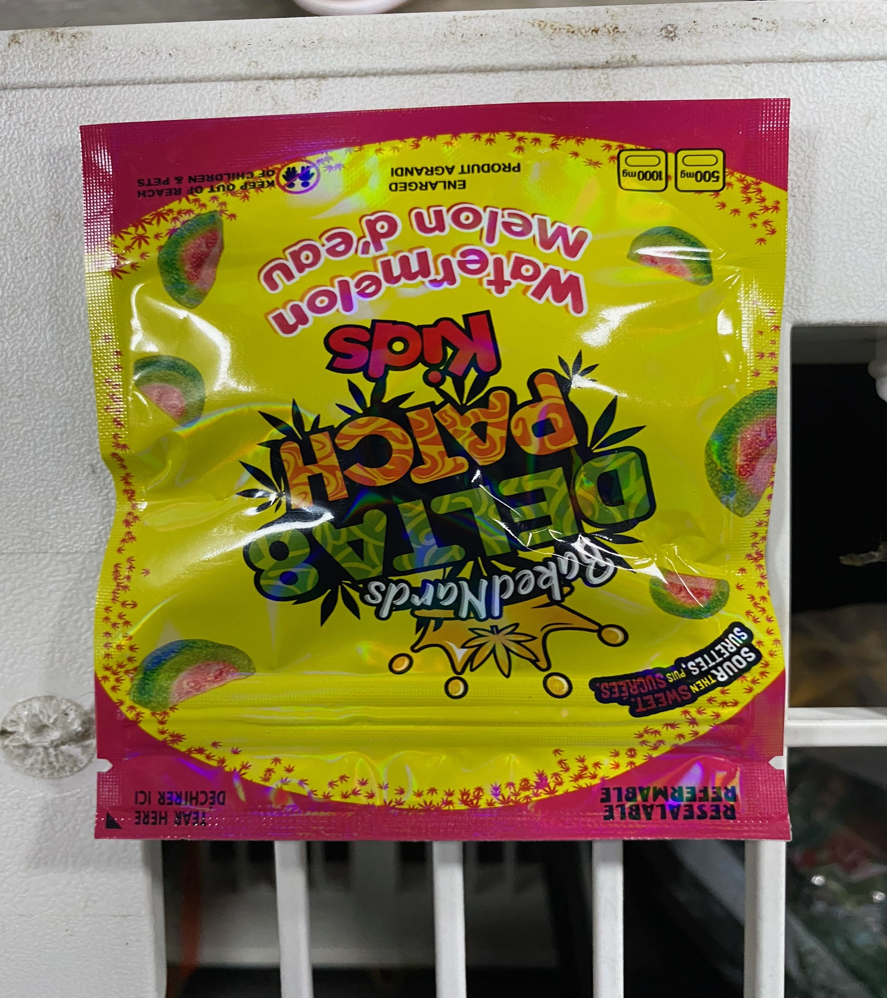
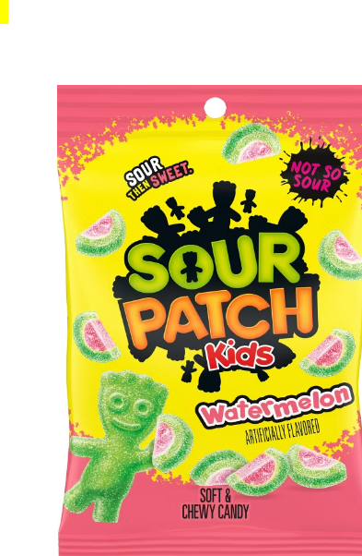
What’s wrong with this product?
Mimics a popular candy gummy brand
Delta 8 Product
Contains 500 mg THC/gummy
Contains 1000 mg in bag
Not in child-resistant packaging
Not to be sold in CT

Slide 13
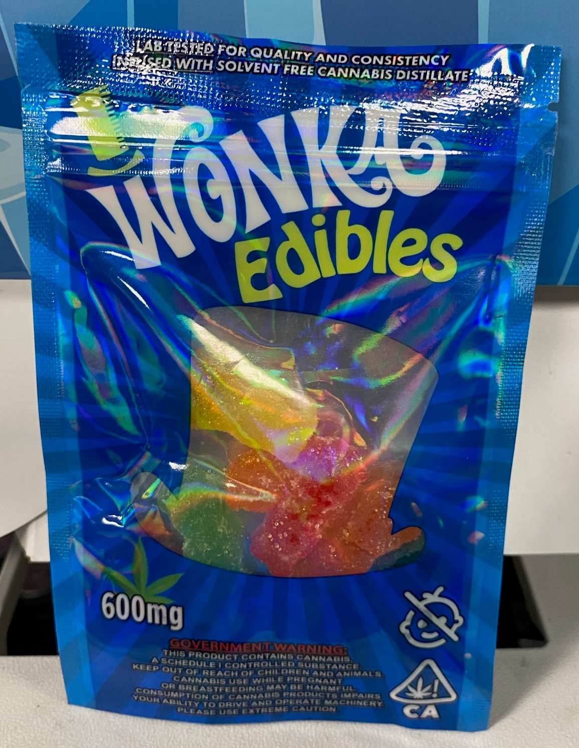
What’s wrong with this product?
Lab tested for quality and consistency. Infused with solvent free cannabis distillate.
Government Warning: This product contains cannabis, a Schedule 1 controlled substance. Keep out of reach of children or animals. Cannabis use while pregnant or breastfeeding may be harmful. Consumption of cannabis products impairs your ability to drive and operate machinery. Please use extreme caution.

Slide 14
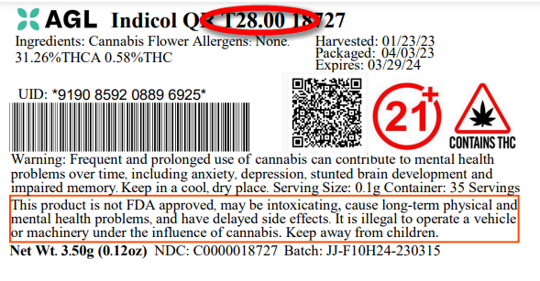
What Cannabis Products Should Look Like…Product Safety and Labeling
Products must be licensed by DCP
Strict labeling and packaging requirements (universal symbols)
Child-resistant packaging
Prohibits products designed to appeal to children
Prohibits certain manufacturing methods, the addition of any additive with nicotine, unless approved by DCP
Notes:
Each product should have a QR code to get the lab results for the product.

Slide 15
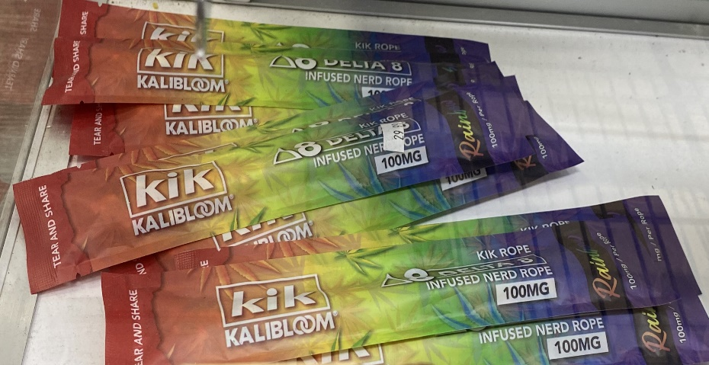
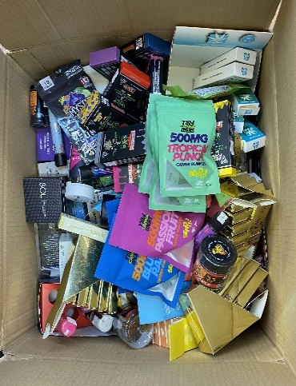
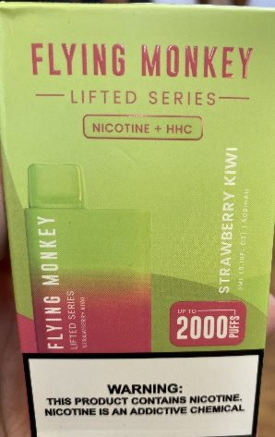
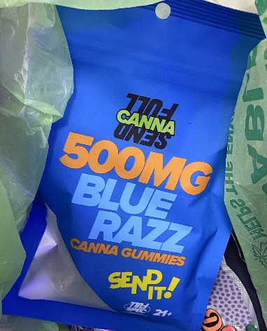
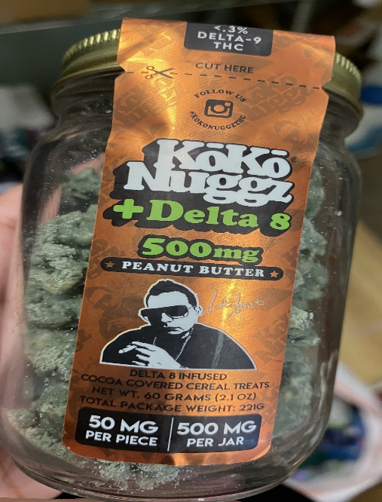
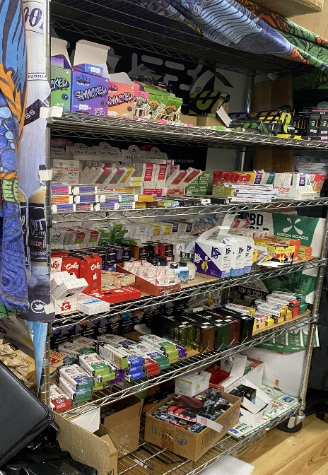
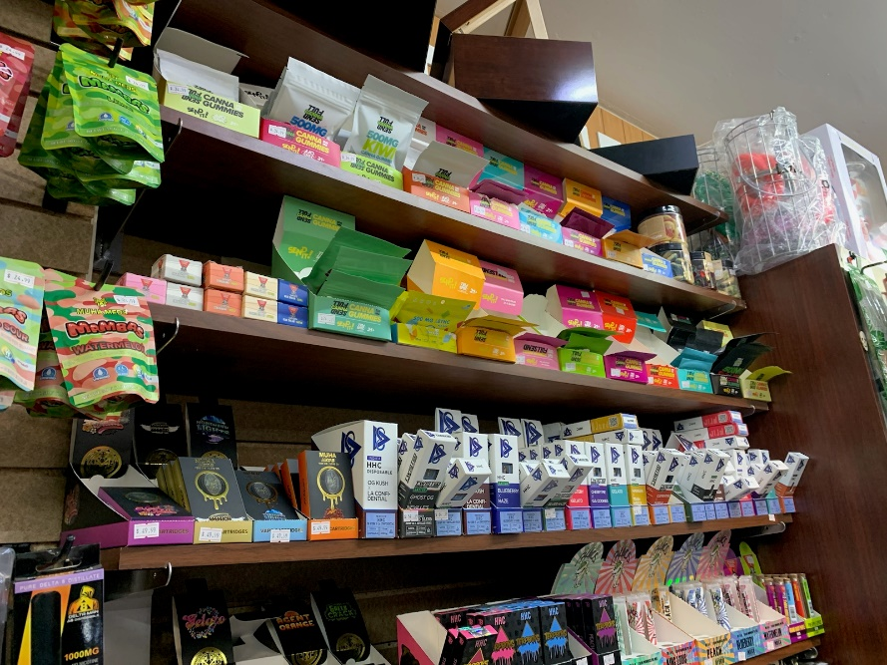
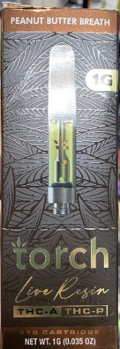
Products Found in Across Connecticut
Notes:
Vapes and gummies.
Found: Bristol, Wallingford, Bridgeport, Shelton.
What are wrong with these products? They aren't allowed to be sold in smoke shops/ convenience stores etc. But they also don't meet the requirements set by DCP for THC/cannabis products in regards to potency, packaging, etc

Slide 16
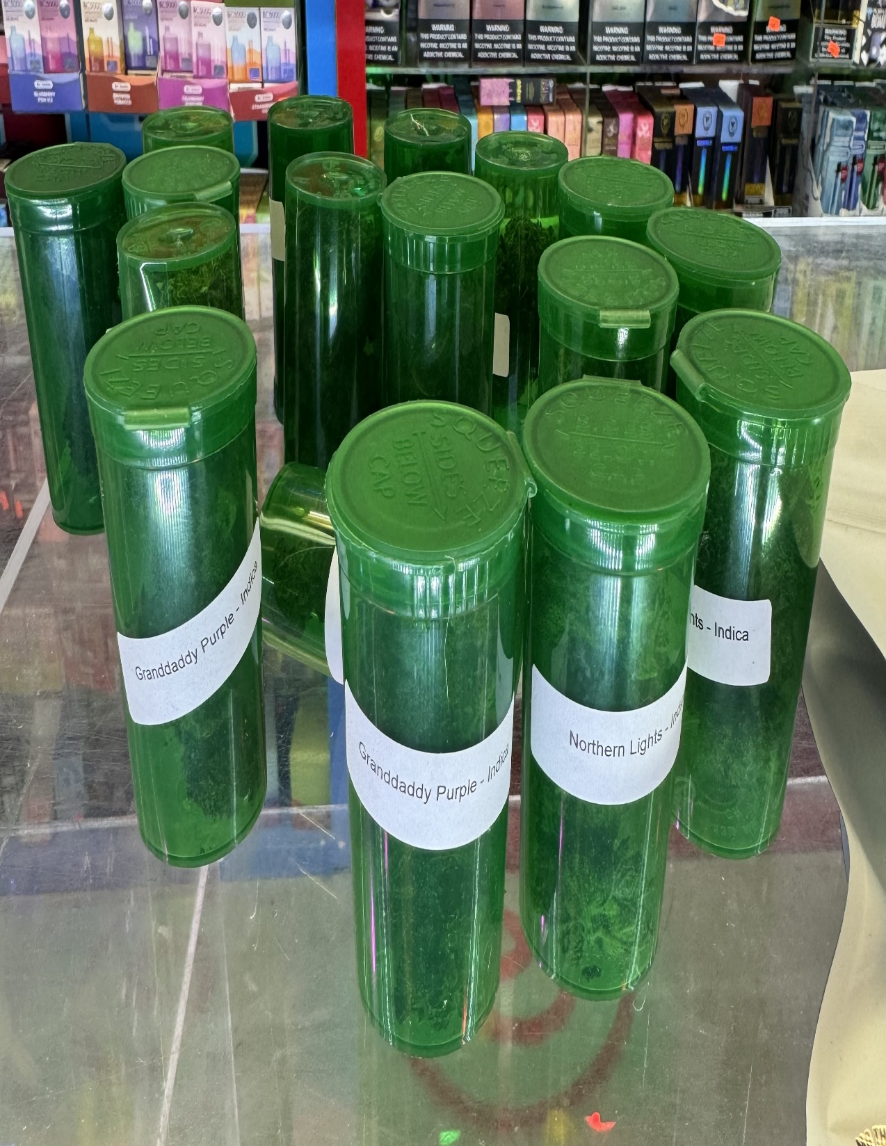
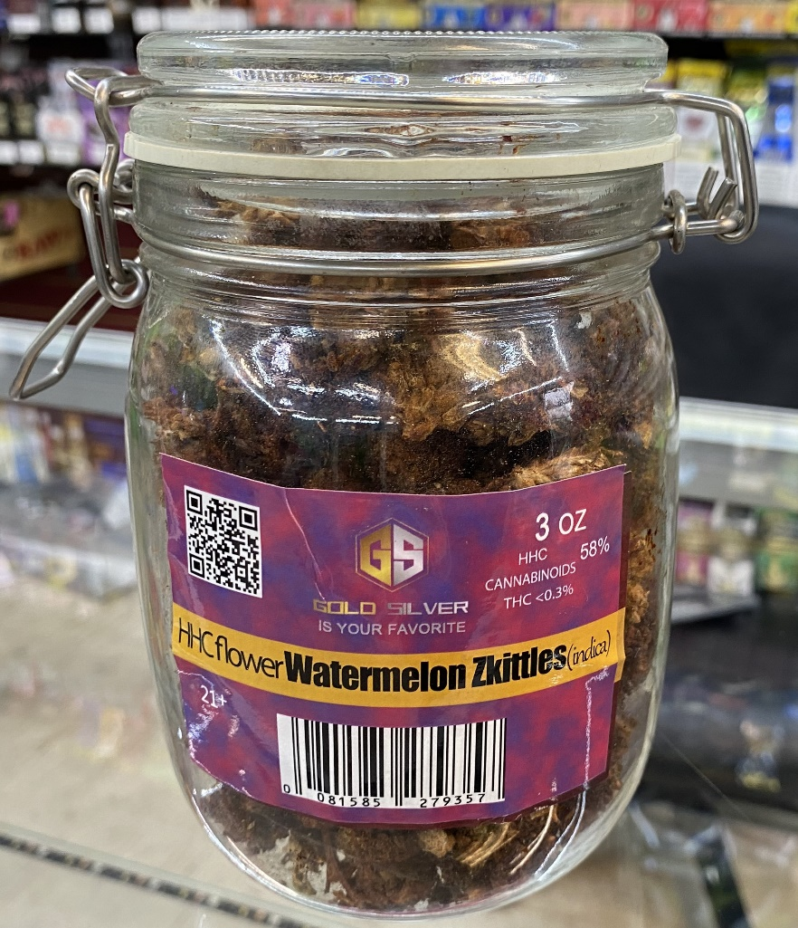
Illegal Packaging and Labeling
Notes:
The photo on the left was from a smoke shop in Shelton that had a large amount of THC/ cannabis products, including: vapes, edibles and flower/bud that they were packaging and labeling themselves.
Products cannot contain any cannabinoid derivative : HHC,HXC, THC-O, THC-P etc. If you scan the QR code it will give you the lab results and they are not consistent with the advertisement of <0.3%
1 MG PER SERVING OR 5 MG PER CONTAINER
The photo on the right was from Bristol.

Slide 17
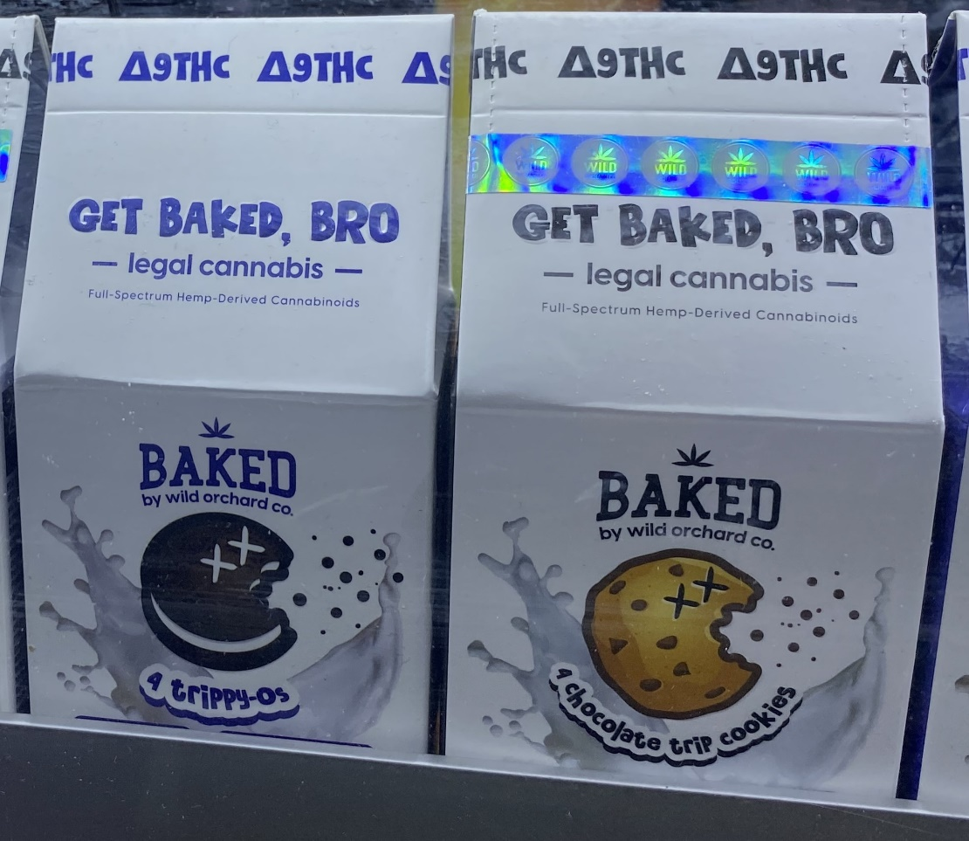
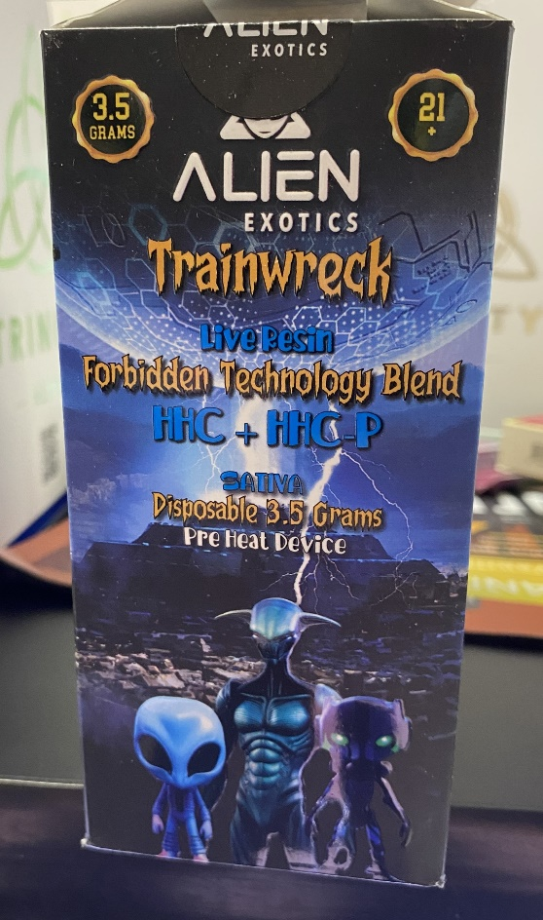
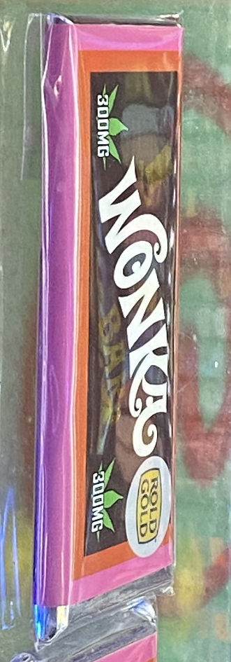
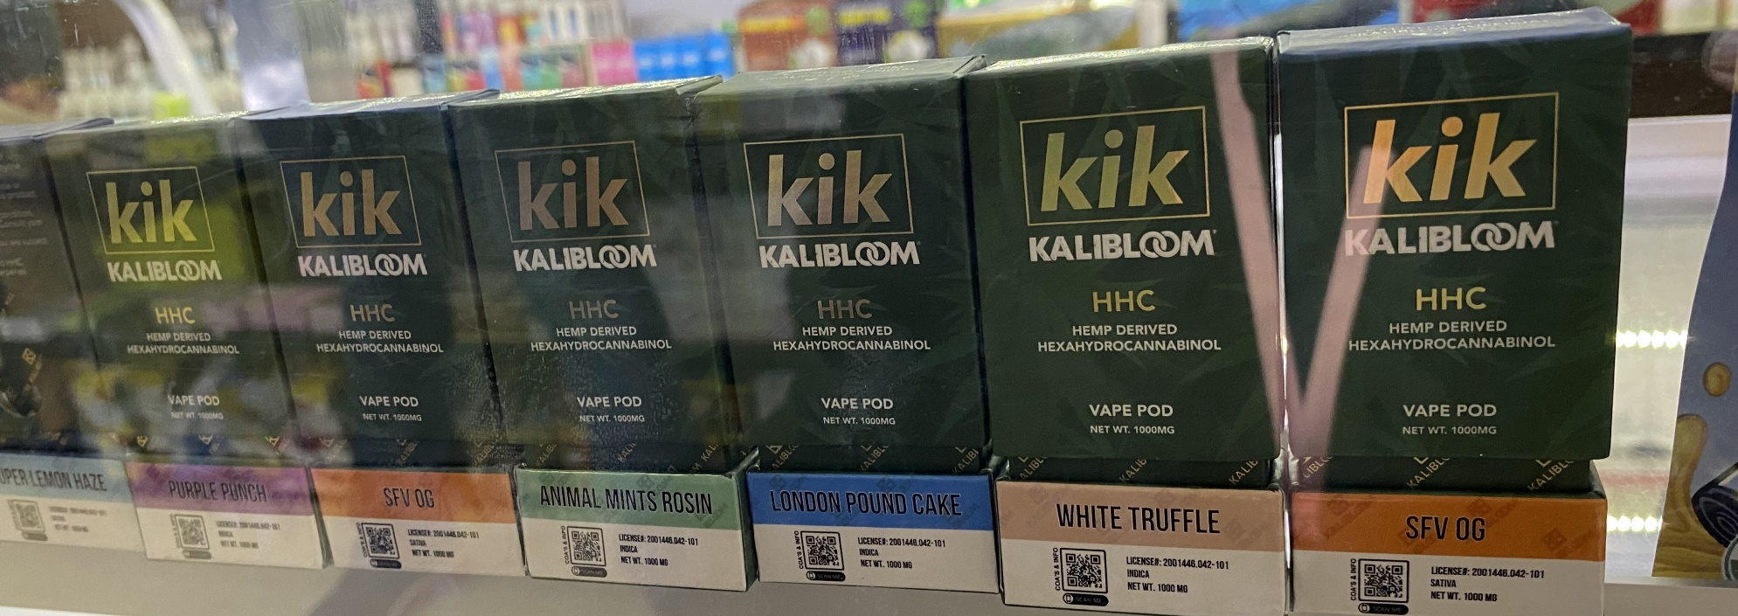
Illegal Products
Notes:
These photos were all from Shelton – all illegal and in a smoke shop.

Slide 18
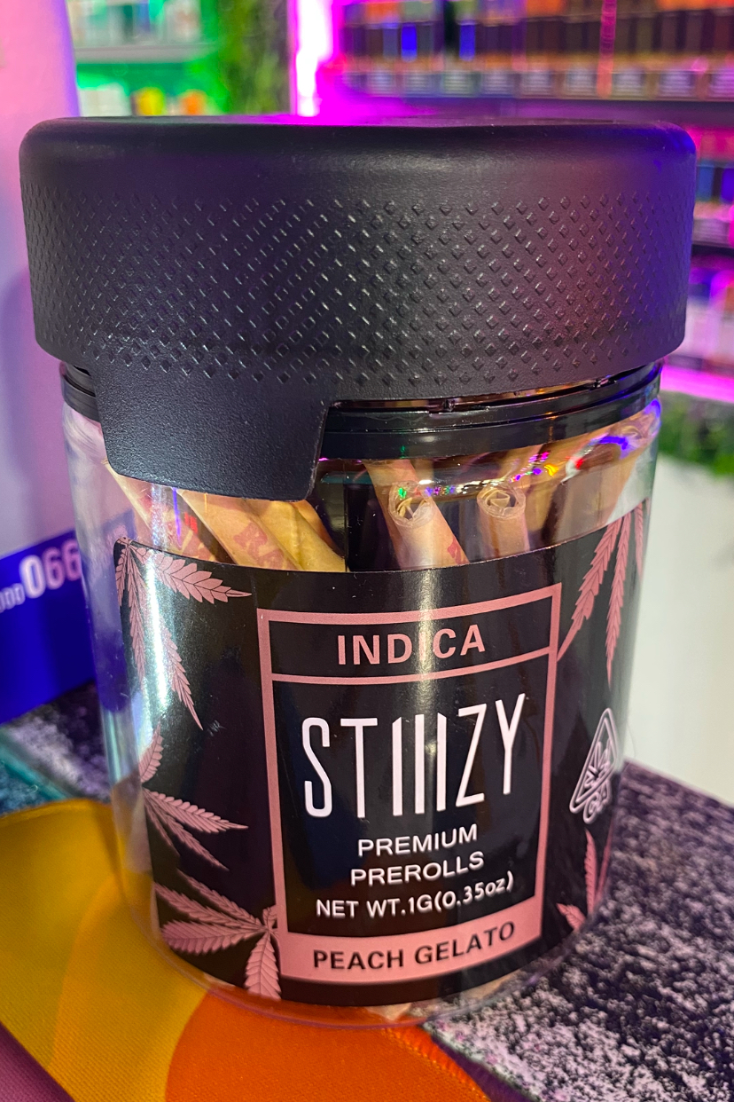
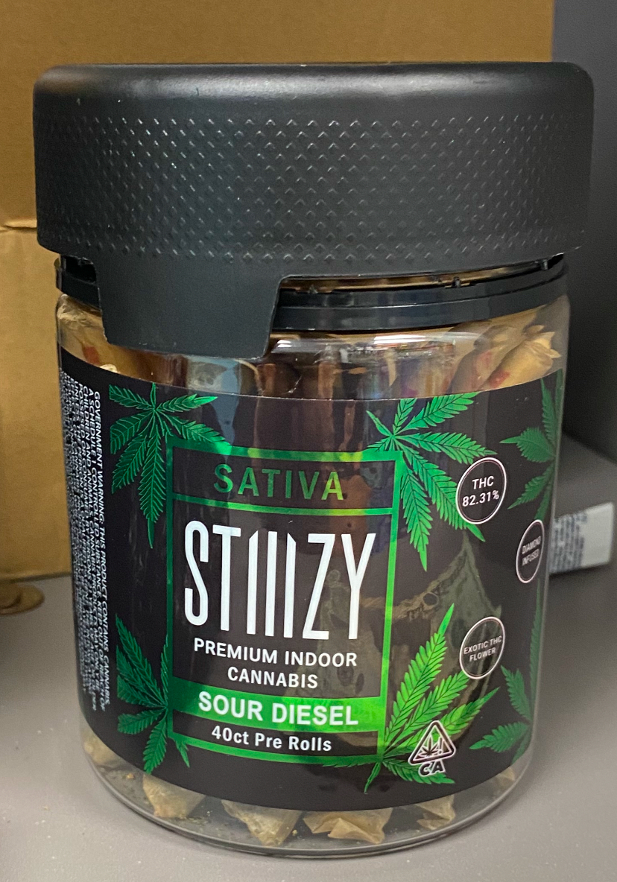
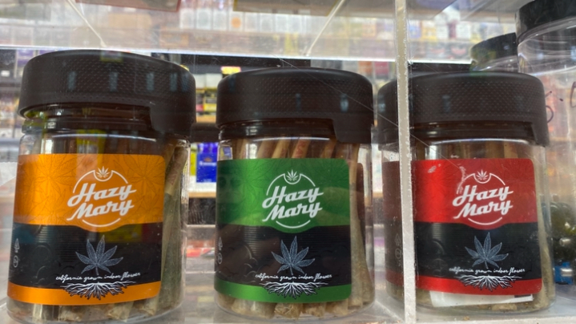
Pre- Rolls

Slide 19
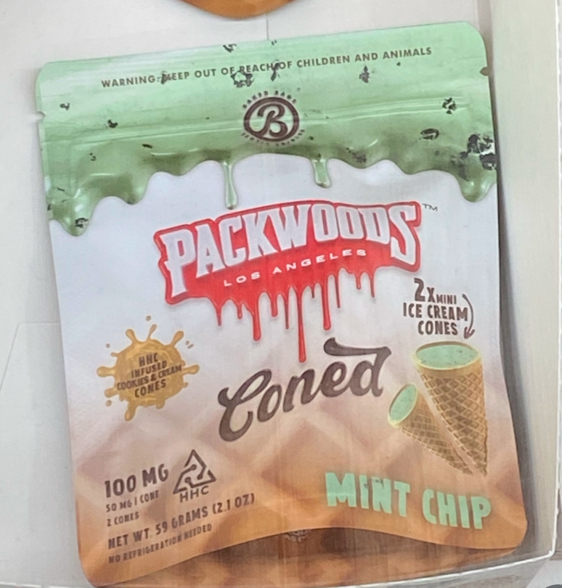
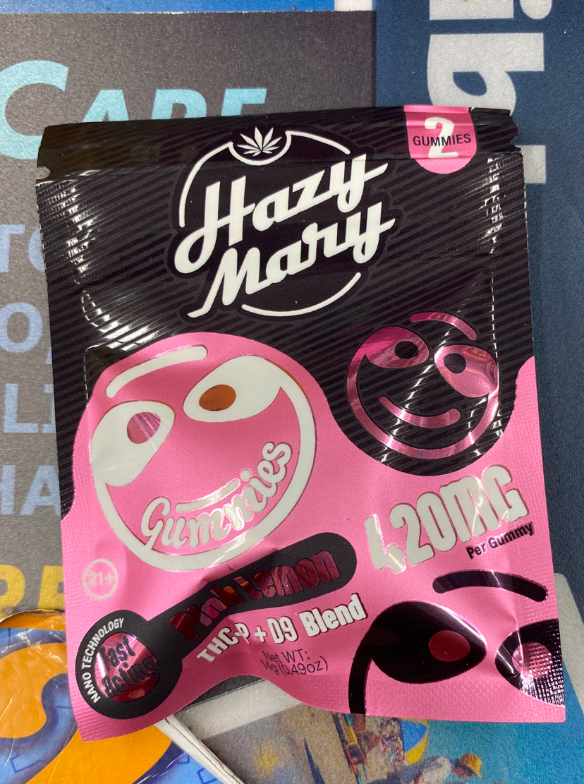

Slide 20
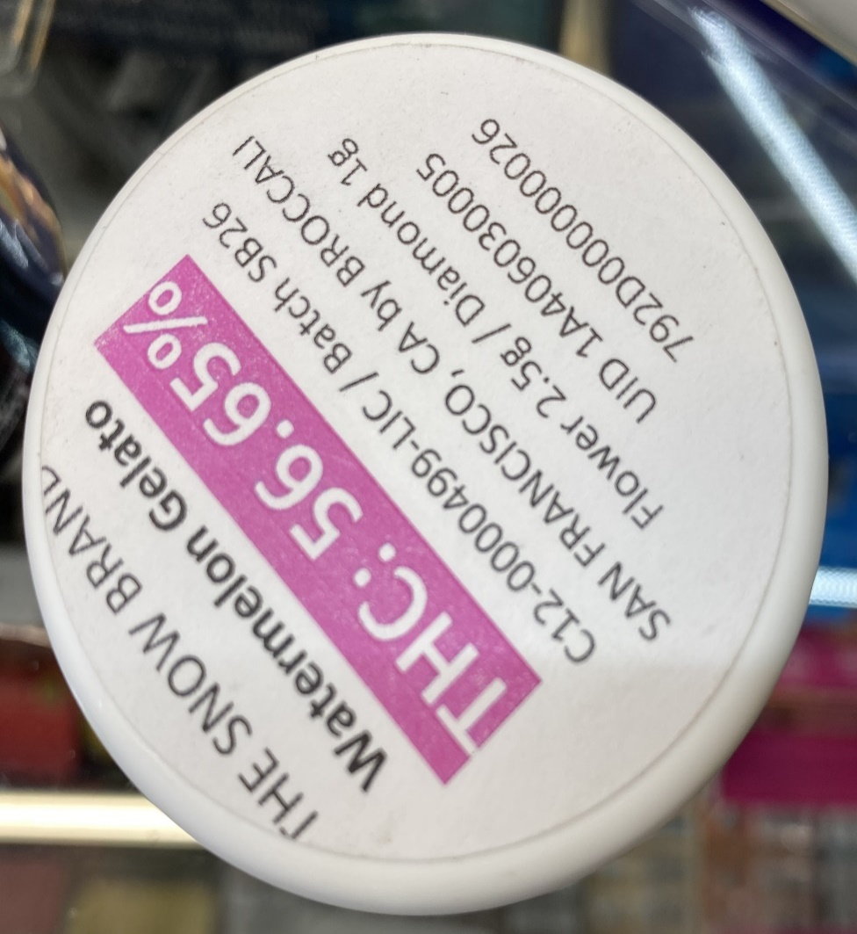
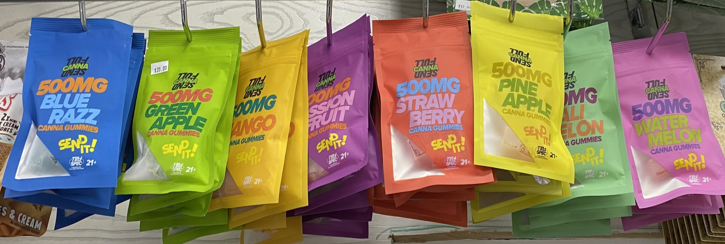
Illegal High THC Products
Notes:
These are from Bristol. You can see the high percentage of THC in these products. None of these are legal.

Slide 21
Additional Questions?

Slide 22
How to Report Establishments
How do we partner?
Daniela.Montes@ct.gov
How to check if establishments (liquor stores) have endorsements to sell THC-infused beverages?
elicense.ct.gov
How to report retailers to DCP?
dcp.cannabis@ct.gov

Slide 23
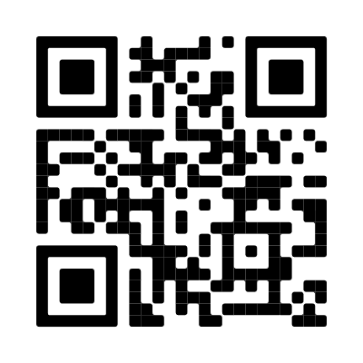
Thank you!
Access the Be in the Know CT toolkit
Denique Weidema-Lewis
Behavioral Health Program Manager
Denique.Weidema-Lewis@ct.gov
Daniela Montes-Hawley
Lead Special Investigator
Daniela.montes@ct.gov

